Slide 1






Object Oriented Analysis & Design
Engr. Abdul-Rahman Mahmood
DPM, MCP, QMR(ISO9001:2000)
armahmood786@yahoo.com alphapeeler.sf.net/pubkeys/pkey.htm pk.linkedin.com/in/armahmood www.twitter.com/alphapeeler www.facebook.com/alphapeeler
alphasecure@gmail.com http://alphapeeler.sourceforge.net http://alphapeeler.tumblr.com armahmood786@jabber.org alphapeeler@aim.com
abdulmahmood-sss alphasecure armahmood786@hotmail.com
http://alphapeeler.sf.net/me
mahmood_cubix 48660186 alphapeeler@icloud.com
http://alphapeeler.sf.net/acms/

Slide 2


Slide 3

Adapter Design Pattern
Adapter pattern works as a bridge between two incompatible interfaces.
This type of design pattern comes under structural pattern as this pattern combines the capability of two independent interfaces.
This pattern involves a single class which is responsible to join functionalities of independent or incompatible interfaces.

Slide 4

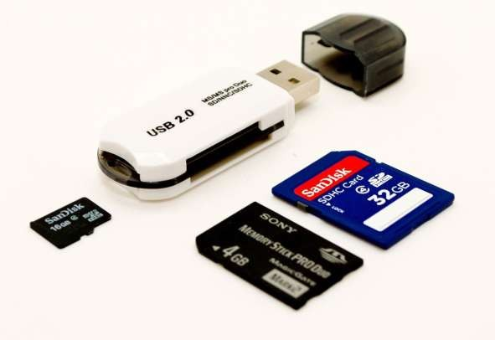
Example 1
 A real life example could be a case of card reader which acts as an adapter between memory card and a laptop.
You plugin the memory card into card reader and card reader into the laptop so that memory card can be read via laptop.

Slide 5

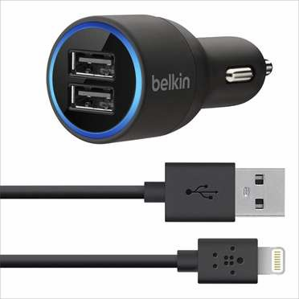
Example 2
 A real life example could be a Car mobile charger which acts as an adapter between cell phone USB cable and a car cigarette lighter power supply. You plugin the USB cable into car charger interface and car charger into the cigarette lighter power supply so that your cell phone can get the appropriate voltage required for charging.

Slide 6

Example 3
 We are demonstrating use of Adapter pattern via following example in which an audio player device can play mp3 files only and wants to use an advanced audio player capable of playing vlc and mp4 files.

Slide 7

Implementation
We have a MediaPlayer interface and a concrete class AudioPlayer implementing
the MediaPlayer interface. AudioPlayer can play mp3 format audio files by default.
We are having another
interface AdvancedMediaPlayer and concrete classes implementing the AdvancedMediaPlayer interface.
These classes can play vlc and mp4 format files.

Slide 8

Implementation
We want to make AudioPlayer to play other formats as well. To attain this, we have created an adapter
class MediaAdapter which implements the MediaPlayer interface and
uses AdvancedMediaPlayer objects to play the required format.
AudioPlayer uses the adapter
class MediaAdapter passing it the desired audio type without knowing the actual class which can play the desired format. AdapterPatternDemo, our demo class will use AudioPlayer class to play various formats.

Slide 9

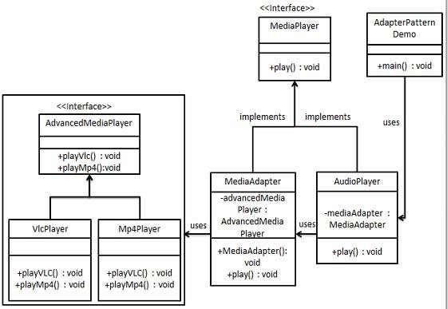
MediaAdapter

Slide 10

Step 1
Create interfaces for Media Player and Advanced Media Player.
MediaPlayer.java
public interface MediaPlayer {
public void play(String audioType, String fileName);
}
 AdvancedMediaPlayer.java
public interface AdvancedMediaPlayer { public void playVlc(String fileName); public void playMp4(String fileName);
}

Slide 11

Step 2
Create concrete classes implementing the AdvancedMediaPlayer interface.
VlcPlayer.java
public class VlcPlayer implements AdvancedMediaPlayer{
@Override
public void playVlc(String fileName) { System.out.println("Playing vlc file. Name: "+ fileName);
}
@Override
public void playMp4(String fileName) {
//do nothing
}
}

Slide 12

Step 2
Create concrete classes implementing the AdvancedMediaPlayer interface.
Mp4Player.java
public class Mp4Player implements AdvancedMediaPlayer{
@Override
public void playVlc(String fileName) {
//do nothing
}
@Override
public void playMp4(String fileName) { System.out.println("Playing mp4 file. Name: "+ fileName);
}
}

Slide 13

Step 3
 Create adapter class implementing
the MediaPlayer interface. (MediaAdapter.java)
public class MediaAdapter implements MediaPlayer { AdvancedMediaPlayer advancedMusicPlayer; public MediaAdapter(String audioType){
if(audioType.equalsIgnoreCase("vlc") ){ advancedMusicPlayer = new VlcPlayer();
} else if (audioType.equalsIgnoreCase("mp4")){
advancedMusicPlayer = new Mp4Player();
} }
@Override
public void play(String audioType, String fileName) { if(audioType.equalsIgnoreCase("vlc")){
advancedMusicPlayer.playVlc(fileName);
} else if(audioType.equalsIgnoreCase("mp4")){ advancedMusicPlayer.playMp4(fileName);
}
}
}

Slide 14

Step 4
Create concrete class implementing the MediaPlayer interface.
AudioPlayer.java
public class AudioPlayer implements MediaPlayer { MediaAdapter mediaAdapter;
@Override
public void play(String audioType, String fileName) {
//inbuilt support to play mp3 music files if(audioType.equalsIgnoreCase("mp3")){
System.out.println("Playing mp3 file. Name: " + fileName);
}
//mediaAdapter is providing support to play other file formats else if(audioType.equalsIgnoreCase("vlc") ||
audioType.equalsIgnoreCase("mp4")){ mediaAdapter = new MediaAdapter(audioType); mediaAdapter.play(audioType, fileName);
} else{
System.out.println("Invalid media. " + audioType + " format not supported");
}
}}

Slide 15

Step 5
Use the AudioPlayer to play different types of audio formats.
AdapterPatternDemo.java
public class AdapterPatternDemo {
public static void main(String[] args) { AudioPlayer audioPlayer = new AudioPlayer();
audioPlayer.play("mp3", "beyond the horizon.mp3"); audioPlayer.play("mp4", "alone.mp4"); audioPlayer.play("vlc", "far far away.vlc"); audioPlayer.play("avi", "mind me.avi");
}
}

Slide 16

Step 6
 Verify the output.
Playing mp3 file. Name: beyond the horizon.mp3
Playing mp4 file. Name: alone.mp4 Playing vlc file. Name: far far away.vlc Invalid media. avi format not supported

Slide 18

Singleton Pattern
 Singleton pattern is one of the simplest design patterns in Java.
 This type of design pattern comes under creational pattern as this pattern provides one of the best ways to create an object.

Slide 19
Singleton Pattern
 This pattern involves a single class which is responsible to create an object while making sure that only single object gets created.
 This class provides a way to access its only object which can be accessed directly without need to instantiate the object of the class.

Slide 20

Implementation
We're going to create a SingleObject class.
SingleObject class have its constructor as private and have a static instance of itself.
SingleObject class provides a static method to get its static instance to outside world.
SingletonPatternDemo, our demo class will
use SingleObject class to get a SingleObject object.

Slide 21

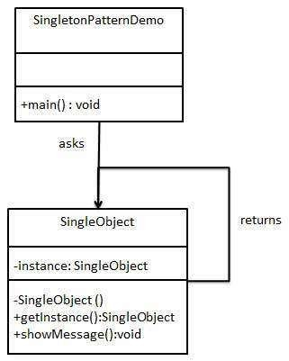
Implementation

Slide 22

Step 1
 Create a Singleton Class. (SingleObject.java)
public class SingleObject {
//create an object of SingleObject
private static SingleObject instance = new SingleObject();
//make the constructor private so that this class cannot be
//instantiated
private SingleObject(){}
//Get the only object available
public static SingleObject getInstance(){ return instance;
}
public void showMessage(){ System.out.println("Hello World!");
}
}

Slide 23

Step 2
Get the only object from the singleton class.
SingletonPatternDemo.java
public class SingletonPatternDemo {
public static void main(String[] args) {
//illegal construct
//Compile Time Error: The constructor SingleObject() is not visible
//SingleObject object = new SingleObject();
//Get the only object available
SingleObject object = SingleObject.getInstance();
//show the message object.showMessage();
}
}

Slide 24

Step 3
 Verify the output.
Hello World!

Slide 26

Factory Pattern
 Factory pattern is one of the most used design patterns in Java. This type of design pattern comes under creational pattern as this pattern provides one of the best ways to create an object.
 In Factory pattern, we create object without exposing the creation logic to the client and refer to newly created object using a common interface.

Slide 27

Implementation
 We're going to create a Shape interface and concrete classes implementing the Shape interface. A factory class ShapeFactory is defined as a next step.
 FactoryPatternDemo, our demo class will
use ShapeFactory to get a Shape object. It will pass information (CIRCLE / RECTANGLE / SQUARE) to ShapeFactory to get the type of object it needs.

Slide 28

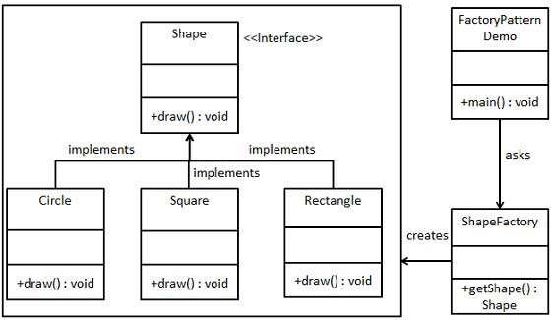
Implementation

Slide 29

Step 1
 Create an interface. (Shape.java)
public interface Shape {
void draw();
}

Slide 30

Step 2
 Create concrete classes implementing the same interface.
public class Rectangle implements Shape { @Override
public void draw() {
System.out.println("Inside Rectangle::draw() method.");
} }
public class Square implements Shape { @Override
public void draw() {
System.out.println("Inside Square::draw() method.");
} }
public class Circle implements Shape { @Override
public void draw() {
System.out.println("Inside Circle::draw() method.");
} }

Slide 31

Step 3
 Create a Factory to generate object of concrete class based on given information. (ShapeFactory.java)
public class ShapeFactory {
//use getShape method to get object of type shape
public Shape getShape(String shapeType){ if(shapeType == null){
return null;
}
if(shapeType.equalsIgnoreCase("CIRCLE")){
return new Circle();
} else if(shapeType.equalsIgnoreCase("RECTANGLE")){ return new Rectangle();
} else if(shapeType.equalsIgnoreCase("SQUARE")){
return new Square();
}
return null;
} }

Slide 32

Step 4
 Use Factory to get object of concrete class by passing information such as type. (FactoryPatternDemo.java)
public class FactoryPatternDemo {
public static void main(String[] args) { ShapeFactory shapeFactory = new ShapeFactory(); Shape shape1 = shapeFactory.getShape("CIRCLE"); shape1.draw();
Shape shape2 = shapeFactory.getShape("RECTANGLE"); shape2.draw();
Shape shape3 = shapeFactory.getShape("SQUARE"); shape3.draw();
}
}

Slide 33

Step 5
 Verify the output.
Inside Circle::draw() method. Inside Rectangle::draw() method. Inside Square::draw() method.

